Slide 1


Diagnostic Analytics
& Data Visualization
Finding the Signals in the Noise.
Identifying Patterns and Communicating the Why
Week 2
01 / 30

Slide 2

THE ANATOMY OF WHY
The Transition: Reporter to Detective
Descriptive
Diagnostic
The temperature is high
The patient has an infection
Sales dropped by 12%
A competitor opened across the street
Traffic is down this month
The Instagram ad credit card expired
Tells you WHAT happened
Tells you WHY it happened
02 / 30

Slide 3
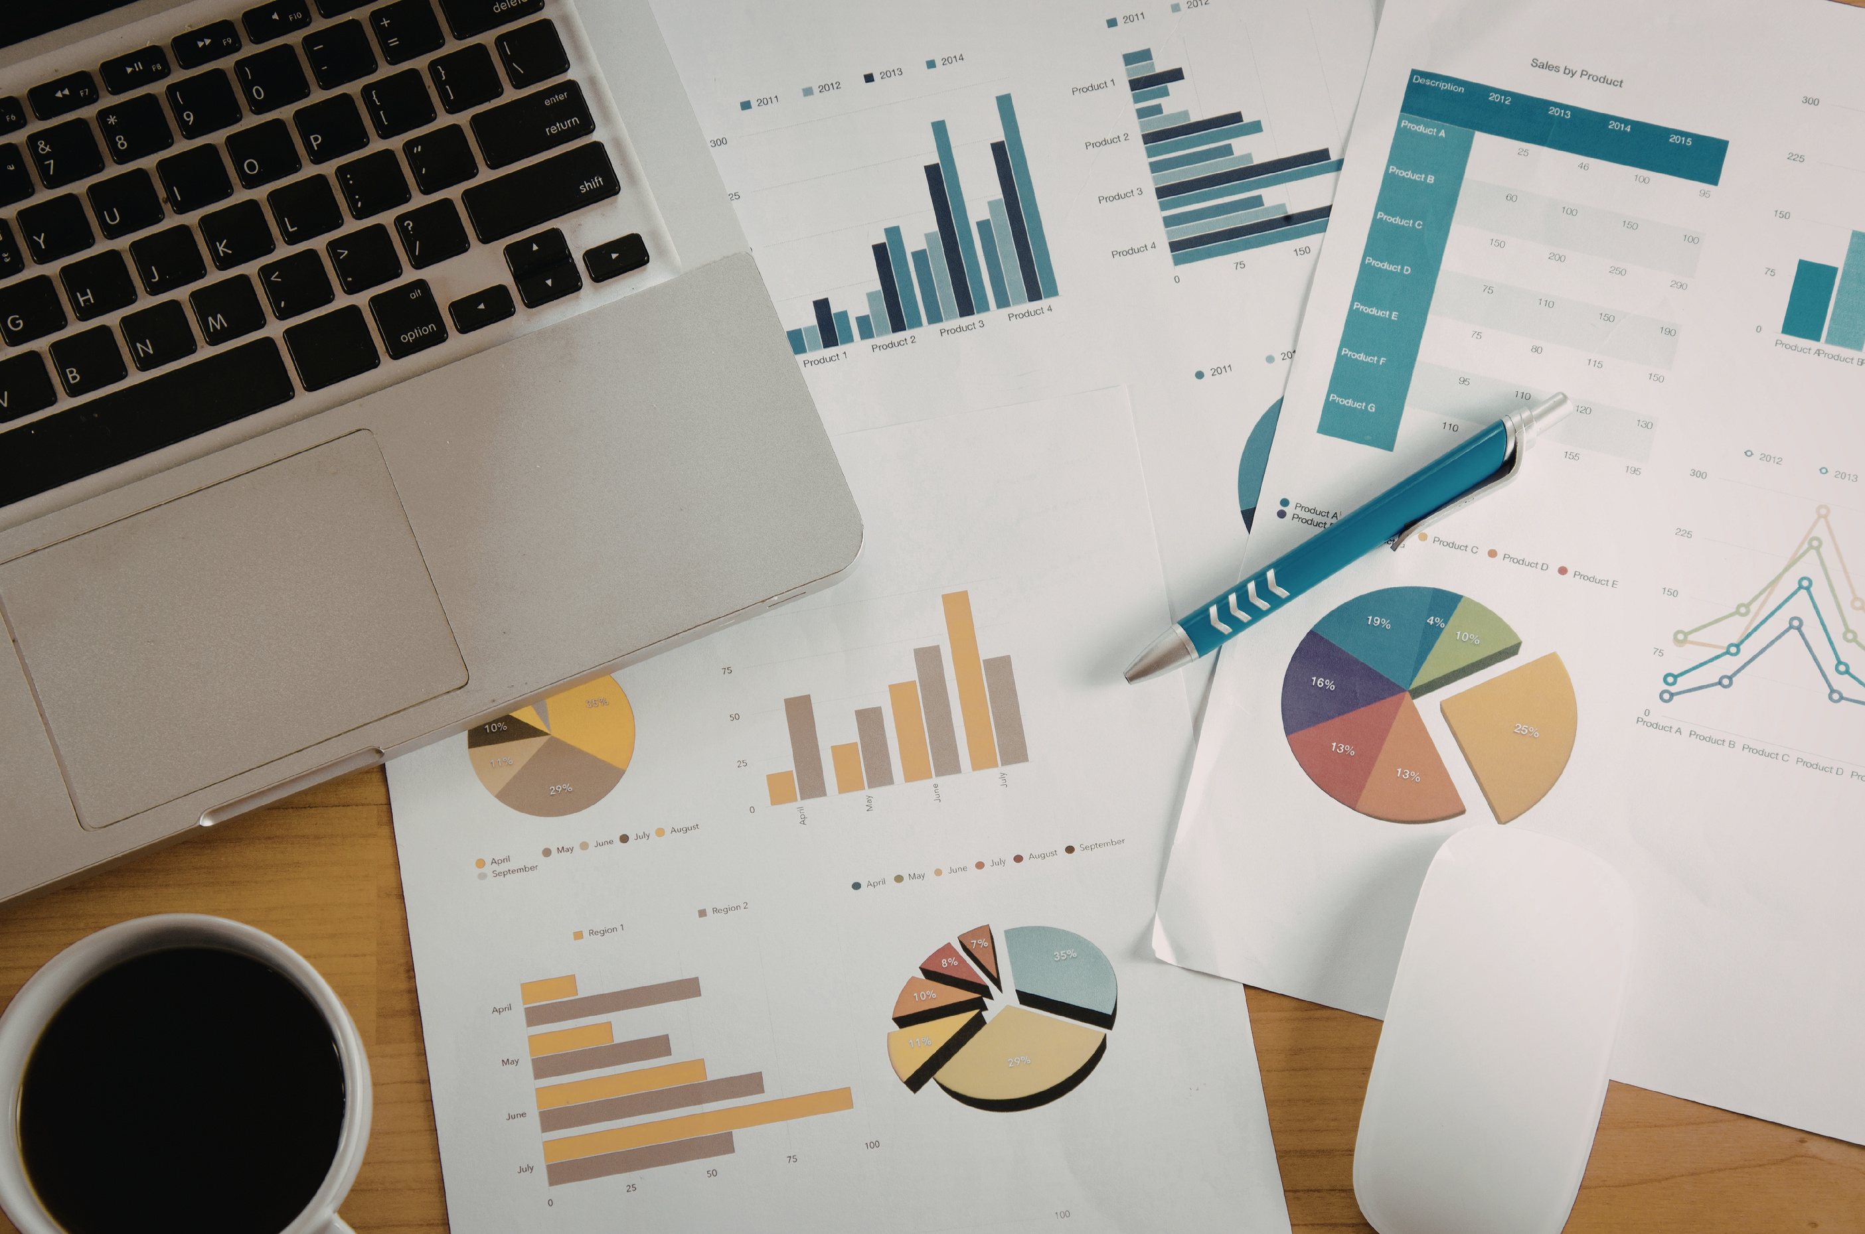
WHY WE USE CHARTS
60,000x
faster, the brain processes visuals compared to text
A 50-row table requires reading every cell. A line chart reveals the peak in 0.1 seconds.
03 / 30

Slide 4
SEE THE DATA
Anscombe's Quartet
Four datasets with identical Mean, Variance, and Correlation
When graphed, they look completely different from each other
Proof that statistics alone can be deeply misleading
You must see the data to truly understand the behavior of the business
Numbers summarize. Charts reveal.
04 / 30

Slide 5
ROOT CAUSE TECHNIQUE
The 5 Whys Technique
Sales are down -> Why? Fewer customers
Fewer customers -> Why? Less website traffic
Less traffic -> Why? The Instagram ad stopped running
Ad stopped -> Why? The credit card on file expired
Root cause: no one was assigned to manage the billing account
05 / 30

Slide 6

SECTION 2
The Art
of Selection
Choosing the right chart is choosing the right argument
06 / 30

Slide 7

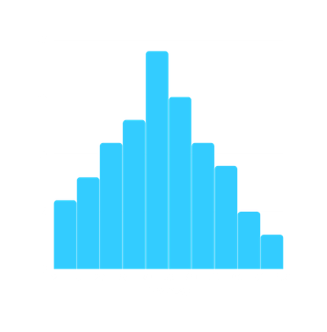
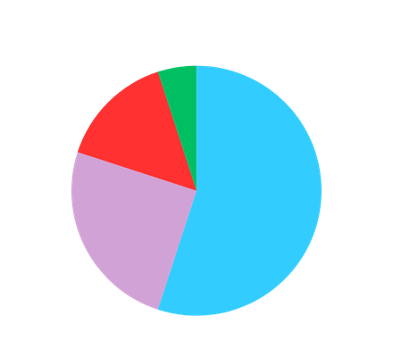
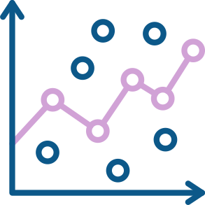
CHART SELECTION
Four Goals, Four Chart Families
Comparison
Distribution
Composition
Relationship
How things differ
from each other
Bar / Column Charts
How values spread
across a range
Histogram / Box Plot
Parts of a whole
at one point in time
Pie / Treemap
Does X affect Y?
Scatter Plot
Correlation
Choosing the wrong chart is like using a hammer to turn a screw. Wrong tool, wrong answer.
07 / 30

Slide 8
COMPARISON CHARTS
Comparison: Bar & Column Charts
Use Column Charts (vertical) to compare values across categories
Use Bar Charts (horizontal) when category names are long
e.g. 'Northwestern Regional Office' | horizontal fits better
Always sort from largest to smallest for instant ranking
Never use 3D bars, depth distorts the actual value
08 / 30

Slide 9
COMPOSITION CHARTS
Composition: Pie Charts & Treemaps
Pie charts show parts of a whole at a single point in time
Never use a Pie for more than 5 categories, it becomes unreadable
If slices are similar in size, the human eye cannot distinguish them
Use a Treemap for complex budget breakdowns with many categories
Rule: if you need a legend to explain it, reconsider the chart type
09 / 30

Slide 10
TREND CHARTS
Trends: Line & Area Charts
Line charts are built for time-series data: revenue, visits, temperature
A line implies a connection between data points, never use for unrelated categories
Connecting 'Apples' and 'Oranges' with a line implies a change that doesn't exist
Area charts add visual weight, useful for showing volume over time
Monthly revenue over 3 years: the perfect use case for a line chart
10 / 30

Slide 11
RELATIONSHIP CHARTS
Relationships: Scatter Plots
Does variable X affect variable Y?
Example: Does temperature predict ice cream sales?
Each dot is one data point, the pattern of dots reveals the relationship
A tight diagonal cluster = strong correlation
This is the direct bridge to Week 7: Regression Analysis
11 / 30

Slide 12
The Golden Rule: Always Start the Y-Axis at Zero
“
If you start a bar chart at 90 to make a change from 91 to 95 look dramatic,
you are not visualizing data.
You are manufacturing a story.
12 / 30

Slide 13
DESIGN PRINCIPLES
Color Strategy in Charts
Use color to highlight, not to decorate
Make everything grey. Use one accent color only for the point that matters.
When everything is colorful, nothing is emphasized
Colorblind-safe palettes: avoid Red-Green combinations
Which chart for a split marketing budget (TV / Radio / Social)? Pie or Treemap.
13 / 30

Slide 14

SECTION 3
Excel
Visualization Tools
From raw data to a Disney land charts
14 / 30

Slide 15
EXCEL CHARTS
The Insert Tab. Your Chart Workshop
Recommended Charts: Excel suggests chart types based on your selected data
Always start with a recommendation, then fine-tune it yourself
An analyst never accepts the default. They ask: does this choice serve the insight?
Chart Elements button (plus icon): toggle titles, labels, gridlines on/off
Change Chart Type: swap any chart to another family in two clicks
15 / 30

Slide 16
SPARKLINES
The Hidden Power
Tiny charts that live inside a single cell
Show 12 months of trend data next to an employee's name, no extra space needed
Perfect for dashboards where screen real estate is scarce
Three types: Line, Column, Win/Loss
Sparklines make tables scannable at a glance, no chart required
16 / 30

Slide 17
HEATMAPS
Conditional Formatting. Heatmaps in a Cell
Color cells automatically based on their value
Stock level sheet: Red when inventory falls below 10 units
The insight is instant, no chart needed, no scanning required
Use color scales for rankings (green = high, red = low)
Icon sets: arrows and traffic lights for executive summaries
17 / 30

Slide 18
LABEL DECISIONS
Data Labels vs. Clean Charts
Use Data Labels When
Keep It Clean When
The exact number is critical
The shape of the trend matters more
e.g. Profit margin: 14.3%
Labels would overlap or clutter
Audience is non-technical
Audience reads charts fluently
You want no ambiguity
A data table below serves better
18 / 30

Slide 19
SECTION 3 • PROFESSIONAL FORMATTING
Formatting for the C-Suite
Remove gridlines, they add noise, not information
Remove chart borders and background boxes
Use Calibri or Arial, clean, readable, universally available
Professionalism is invisible: if they notice your formatting, it is wrong
The goal is for the insight to be the only thing they remember
19 / 30

Slide 20
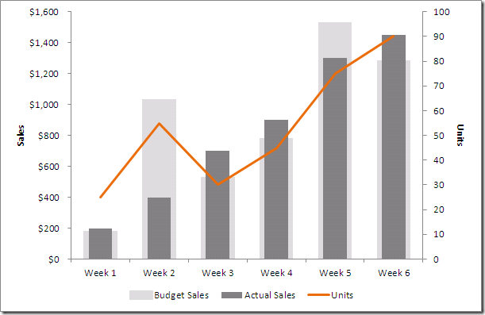
ADVANCED CHARTS
Dual-Axis Charts
Two different scales on one chart: e.g. Units Sold and Total Profit
Use when two metrics are related but live on completely different scales
Units in thousands, Profit in millions, a single axis would flatten one to zero
Warning: non-technical audiences often misread dual-axis charts
Always label both axes clearly and use contrasting colors for each series
20 / 30

Slide 21
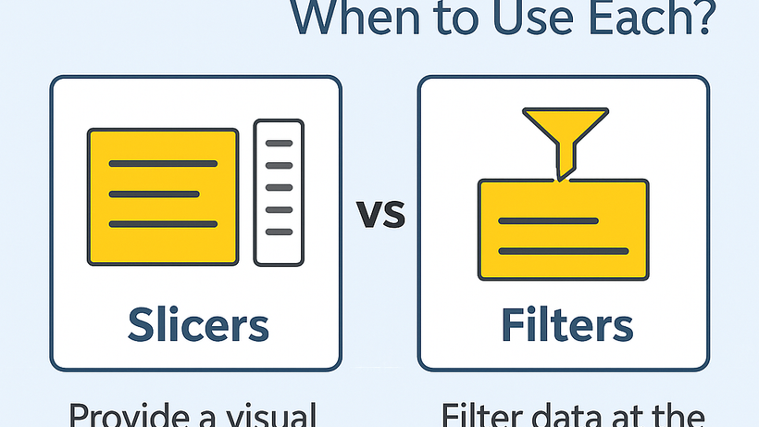
INTERACTIVITY
Slicers & Interactive Filtering
Slicers are buttons that filter your Pivot Table data instantly
Insert -> Slicer -> select a field (Region, Product, Month)
Your entire dashboard updates with one click, no formulas needed
Makes your Excel feel like a professional BI application
Combine with Pivot Charts for a fully interactive reporting layer
21 / 30

Slide 22
FINAL RULES
Two Rules That Change Everything
Always Sort Your Charts
The 10-Foot Test
Bar charts: largest to smallest
Step back 10 feet from your screen
Makes ranking instant for the viewer
Can you understand the chart?
Unsorted bars force the eye to search
If not, simplify
Sorted bars answer the question immediately
Clarity beats complexity every time
22 / 30

Slide 23
You Soft Skill For Today
The Story
& The Ethics
Clarity is more important than beauty
23 / 30

Slide 24
SECTION 4 • STORYTELLING
The Data Storytelling Framework
1
2
3
Context
>
Evidence
>
Conclusion
The Problem
What situation
are we in?
The Chart
What does the
data show?
The Action
What should
we do now?
24 / 30

Slide 25
SECTION 4 • BENCHMARKS
Context Is King
A 20% growth looks impressive until you add context
If the market grew by 50%, your 20% is actually underperformance
Diagnostic analytics always compares your data to a benchmark
Benchmarks can be: last year, competitors, industry average, your own target
Never show a number without its reference point
25 / 30

Slide 26
ETHICS
How to Lie with Charts
Truncated axes: starting at 90 to make a small change look massive
Cumulative graphs that never go down, they hide reversals
Improper scaling: making a 2% change look like a 200% change
If the news is bad, show it clearly, hiding it in a confusing chart destroys your credibility
Be an honest broker of truth. Your reputation is built on it.
26 / 30

Slide 27
DIAGNOSTIC SKILL
Spotting the Anomaly
When you see a spike or a dip, do not ignore it
That is exactly where the Why lives
A spike without an explanation is a question that will embarrass you later
Isolate the anomaly: what changed that day? External event? Internal process?
The analyst who finds the anomaly first is the most valuable person in the room
27 / 30

Slide 28


SECTION 4 • HUMAN-IN-THE-LOOP
Interpreting Sentiment
AI Answer
Human Answer
+
What the algorithm sees
What the context reveals
Customer complaints
rose by 10%.
That is all.
Complaints rose because
our new app update
crashes on older phones.
28 / 30

Slide 29
DASHBOARD PRINCIPLES
Dashboard Design Principles
Most important KPI goes top-left, that is where human eyes land first
One insight per chart, never combine two messages into one visual
Use white space intentionally, breathing room reduces cognitive load
A pretty dashboard that doesn't drive a decision is just art, not analytics
29 / 30

Slide 30

Let's Talk.
A picture is worth
a thousand rows of data.
Lab: Visualization assignment, build a diagnostic dashboard in Excel.
Next week: Flow & Logic. Mapping the Business Mind.
30 / 30

